Slide 1
Area between Parabolas

Slide 2
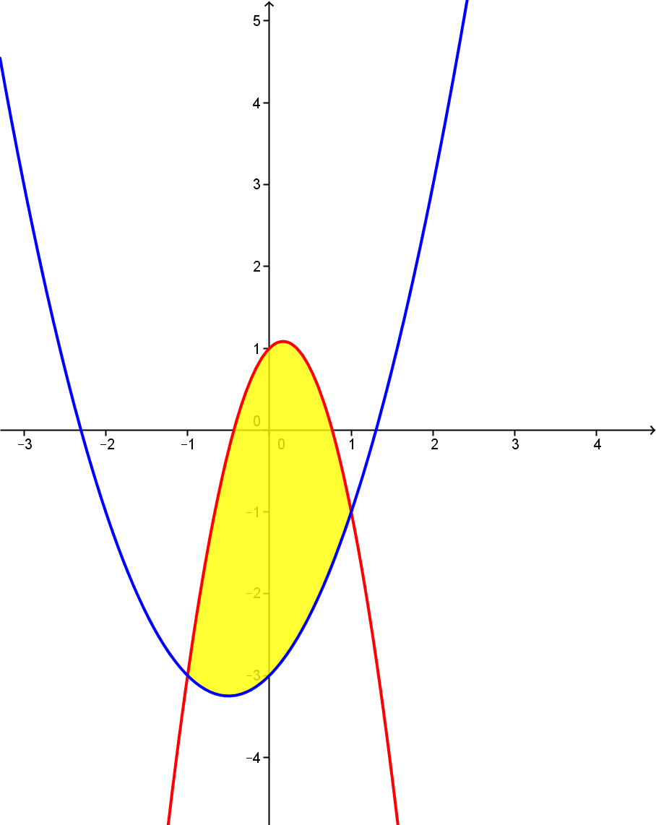


$$g(x)$$
What’s the area bounded by these parabolas?
$$f(x)$$

Slide 3
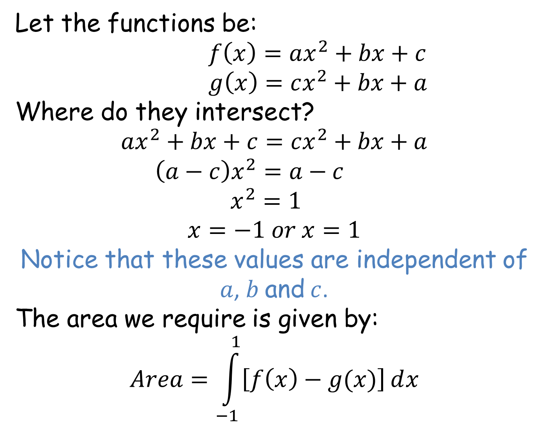
Let the functions be:
$f\left(x\right)=ax^{2}+bx+c$
$g\left(x\right)=cx^{2}+bx+a$
Where do they intersect?
$$ax^{2}+bx+c=cx^{2}+bx+a$$
$\left(a−c\right)x^{2}=a−c$
$x^{2}=1$
$$x=−1 or x=1$$
Notice that these values are independent of
$a$, $b$ and $c$.
The area we require is given by:
$$Area=\int_{−1}^{1}{\left[f\left(x\right)−g(x)\right]ⅆx}$$

Slide 4
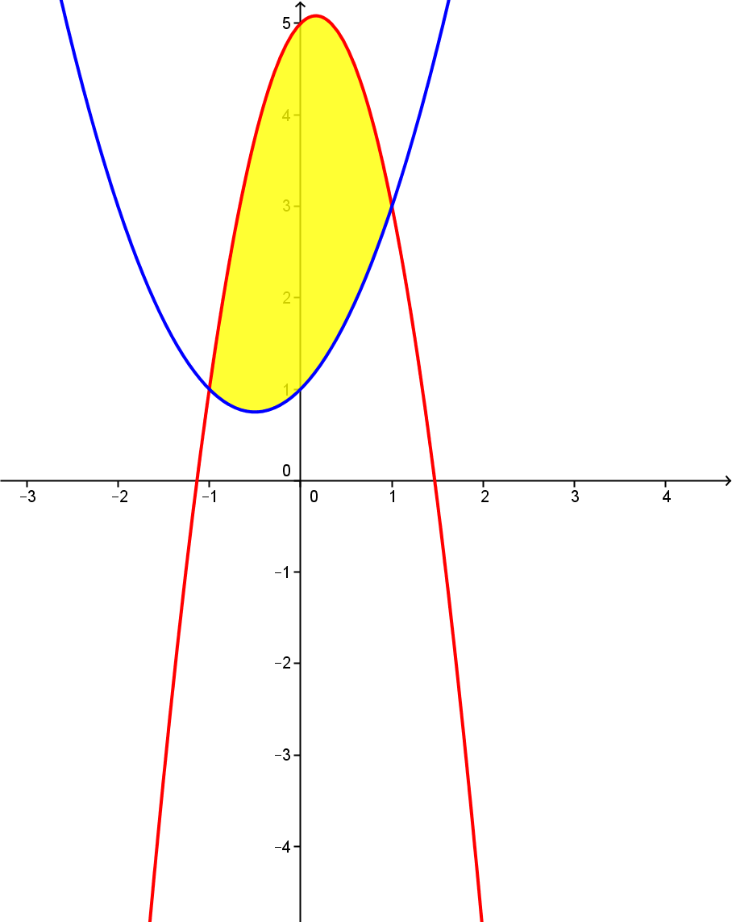
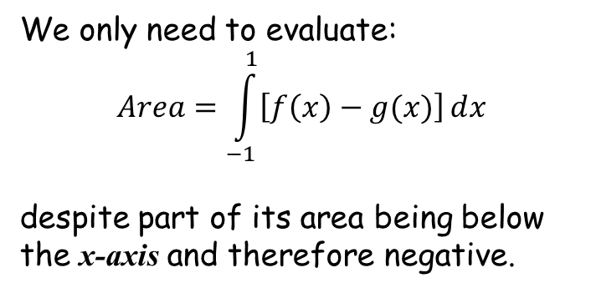



$$g\left(x\right)+4$$
$$g(x)$$
We only need to evaluate:
$$Area=\int_{−1}^{1}{\left[f\left(x\right)−g(x)\right]ⅆx}$$
despite part of its area being below the x-axis and therefore negative.
$$f\left(x\right)+4$$
$$f(x)$$
Imagine both curves translated by the vector $\left(\begin{matrix}0 \\ 4\end{matrix}\right)$. The area wouldn’t change and we would have no negative areas.

Slide 5
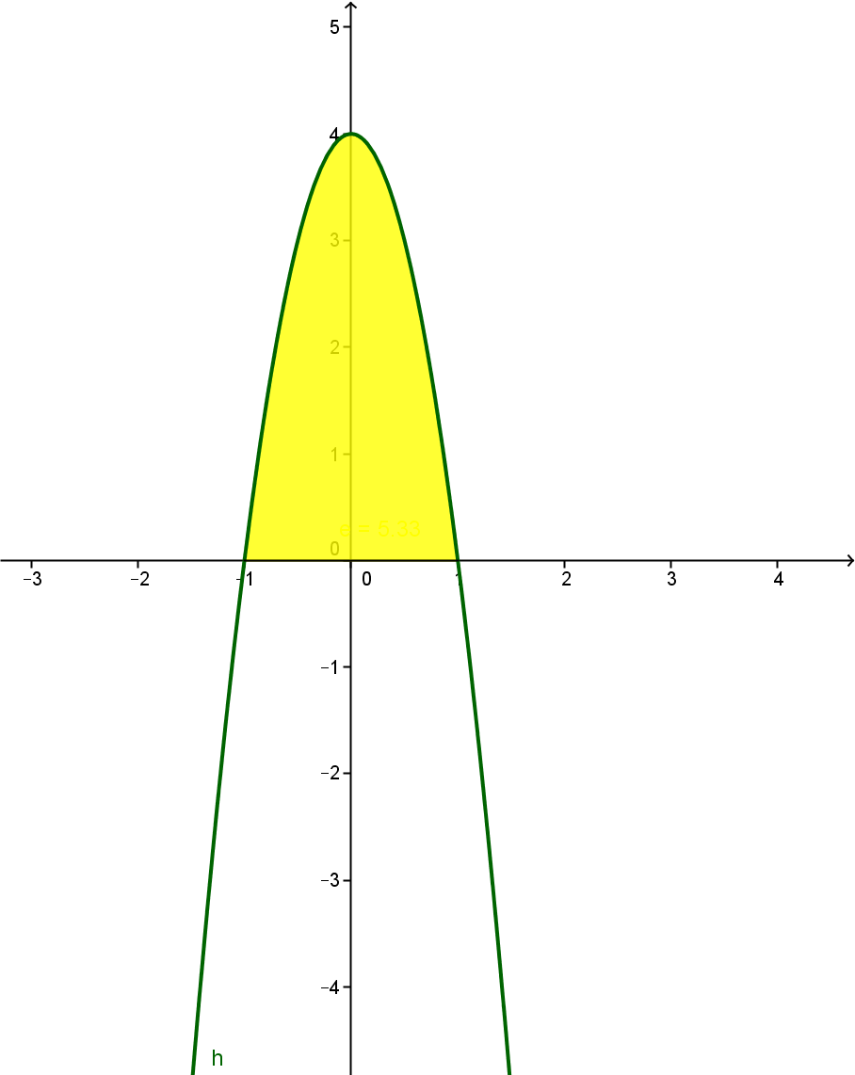
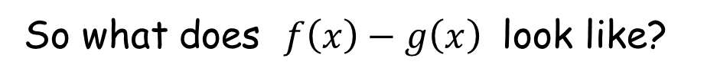



So what does $f\left(x\right)−g\left(x\right)$ look like?
$f(x)$-$g(x)$
$$f(x)$$
$$g(x)$$

Slide 6
So what does $f\left(x\right)−g\left(x\right)$ look like?
$f(x)$-$g(x)$
$$f(x)$$
$$g(x)$$

Slide 7
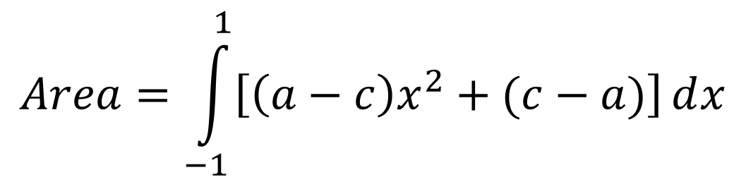

$$Area=\int_{−1}^{1}{\left[\left(a−c\right)x^{2}+(c−a)\right]ⅆx}$$
$=\left[\frac{\left(a−c\right)x^{3}}{3}+\left(c−a\right)x\right]$ $\begin{matrix}1 \\ \\ −1\end{matrix}$
$=\left(\frac{\left(a−c\right)}{3}+c−a\right)−\left(\frac{−\left(a−c\right)}{3}−\left(c−a\right)\right)$
$=\frac{2\left(a−c\right)}{3}+2c−2a$
$Area=\frac{4\left(c−a\right)}{3}$

Slide 8
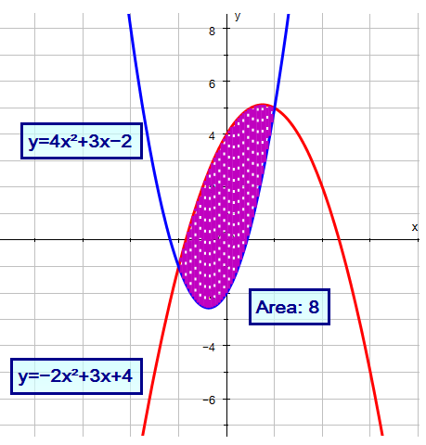
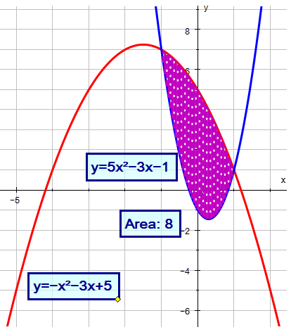
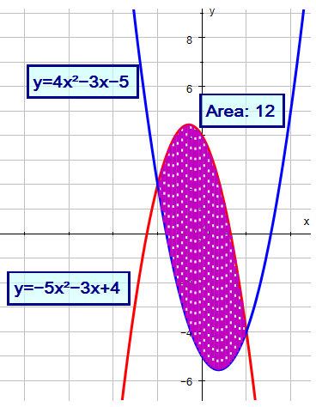
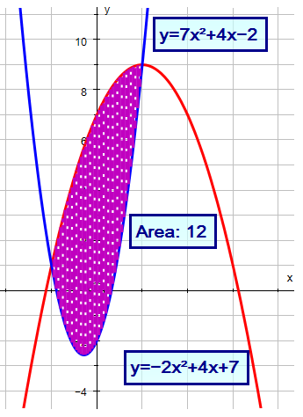
A
B
C
D

Slide 9
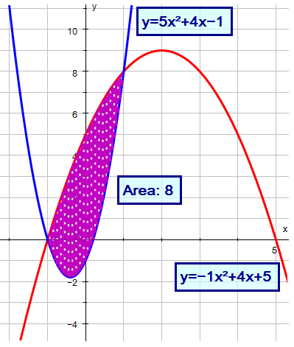
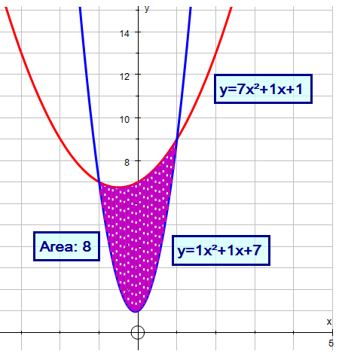
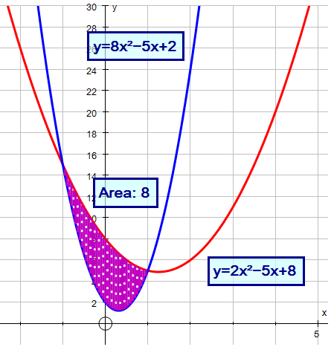
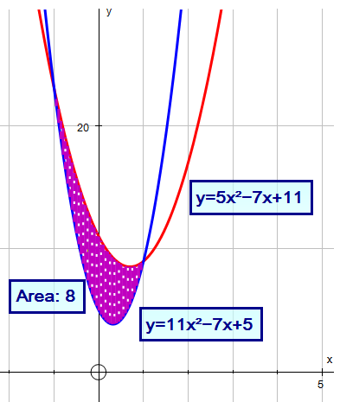
E
F
G
H

Slide 10
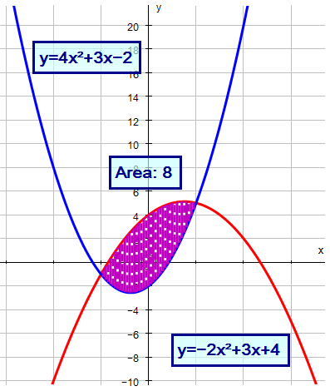
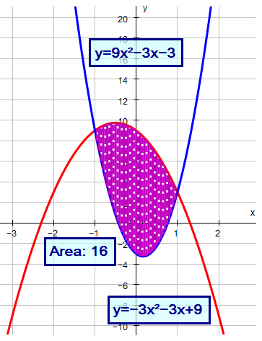
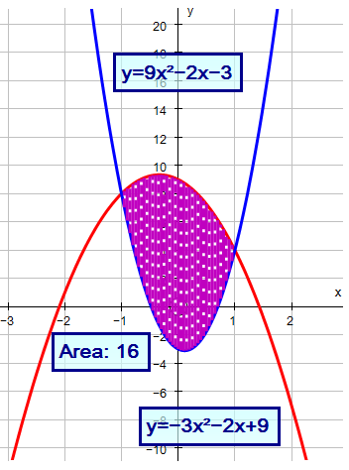
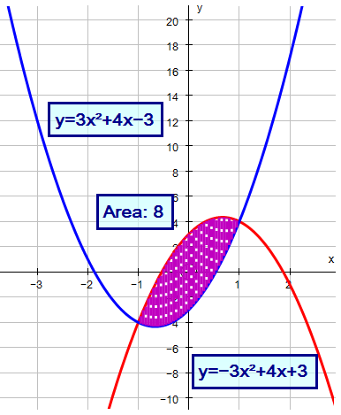
I
J
K
L

Slide 11
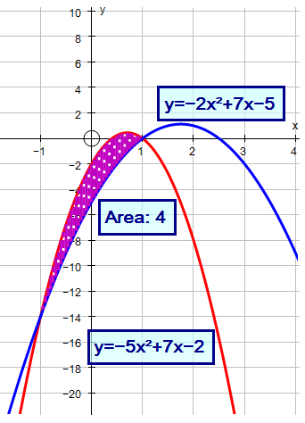
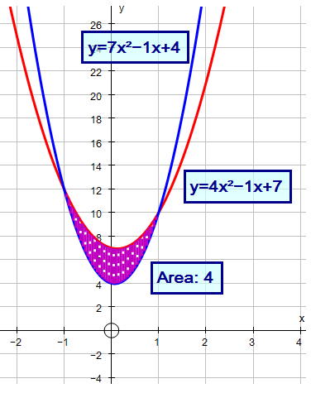
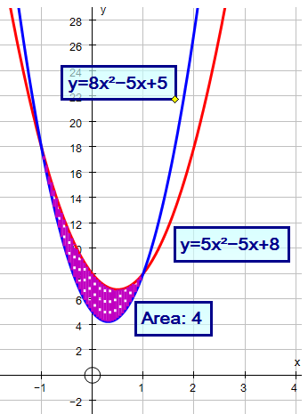
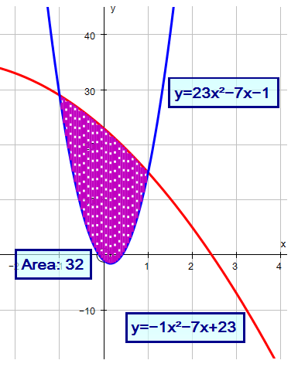
M
N
O
P

Slide 13

Note to Teacher
In all cases $(c−a)$ is divisible by $3$ to make it easier for you to check an answer.

Slide 14
Resources

Slide 15
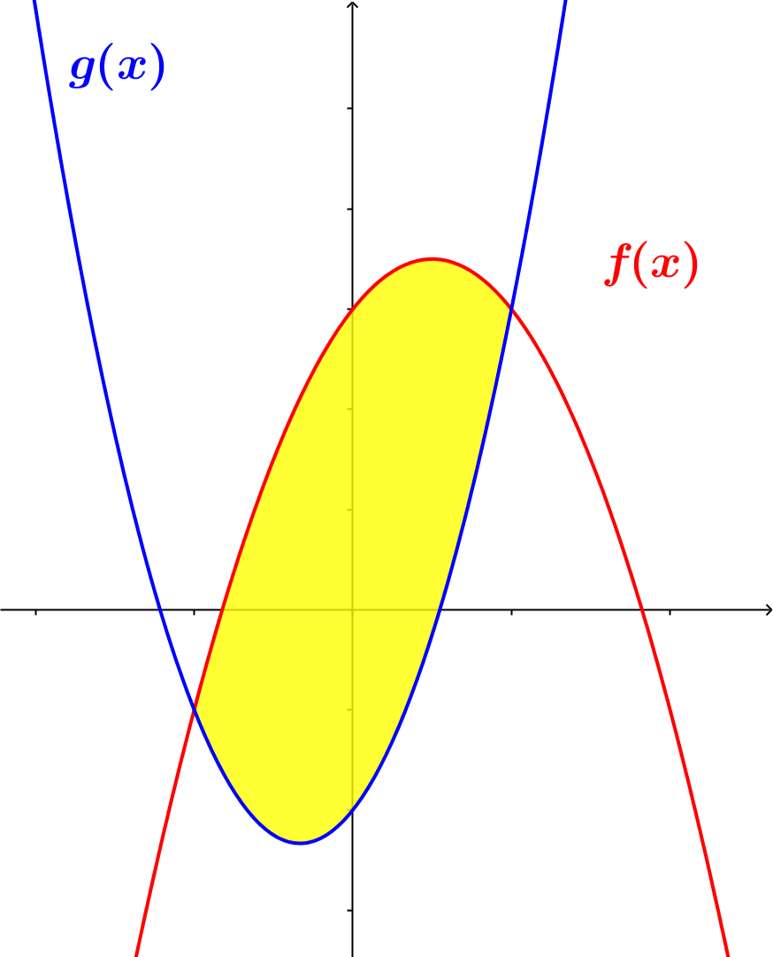
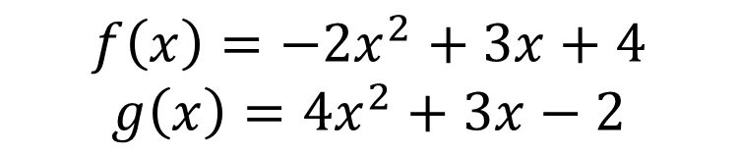
Area between Parabolas
What’s the area bounded by these parabolas?
$$f\left(x\right)=−2x^{2}+3x+4$$
$$g\left(x\right)=4x^{2}+3x−2$$
Not accurately drawn
A
SIC_24

Slide 16
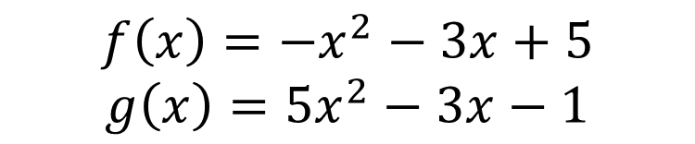
Area between Parabolas
What’s the area bounded by these parabolas?
$$f\left(x\right)=−x^{2}−3x+5$$
$$g\left(x\right)=5x^{2}−3x−1$$
Not accurately drawn
B
SIC_24

Slide 17
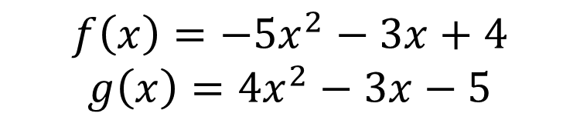
Area between Parabolas
What’s the area bounded by these parabolas?
$$f\left(x\right)=−5x^{2}−3x+4$$
$$g\left(x\right)=4x^{2}−3x−5$$
Not accurately drawn
C
SIC_24

Slide 18
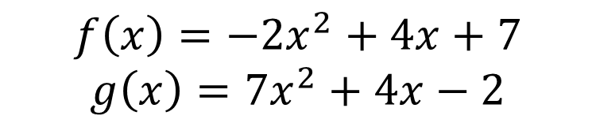
Area between Parabolas
What’s the area bounded by these parabolas?
$$f\left(x\right)=−2x^{2}+4x+7$$
$$g\left(x\right)=7x^{2}+4x−2$$
Not accurately drawn
D
SIC_24

Slide 19
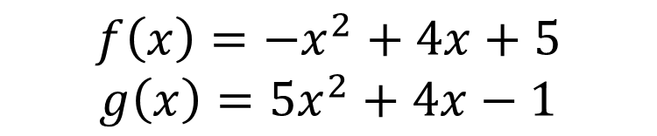
Area between Parabolas
What’s the area bounded by these parabolas?
$$f\left(x\right)=−x^{2}+4x+5$$
$$g\left(x\right)=5x^{2}+4x−1$$
Not accurately drawn
E
SIC_24

Slide 20
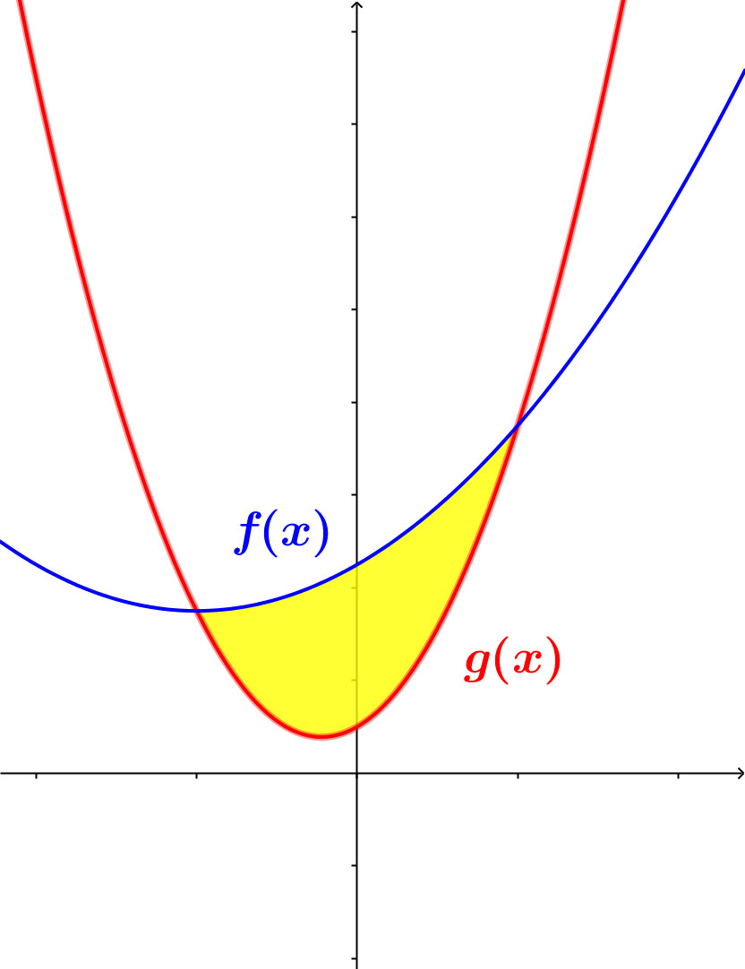
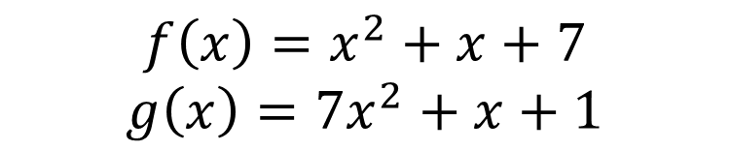
Area between Parabolas
What’s the area bounded by these parabolas?
$$f\left(x\right)=x^{2}+x+7$$
$$g\left(x\right)=7x^{2}+x+1$$
Not accurately drawn
F
SIC_24

Slide 21
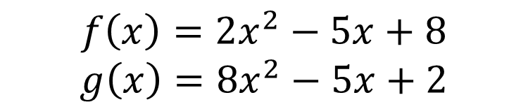
Area between Parabolas
What’s the area bounded by these parabolas?
$$f\left(x\right)=2x^{2}−5x+8$$
$$g\left(x\right)=8x^{2}−5x+2$$
Not accurately drawn
G
SIC_24

Slide 22
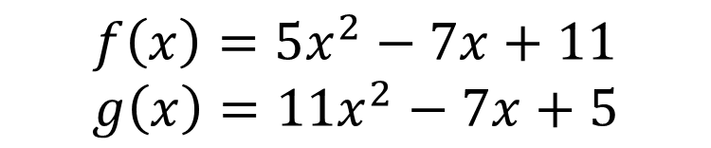
Area between Parabolas
What’s the area bounded by these parabolas?
$$f\left(x\right)=5x^{2}−7x+11$$
$$g\left(x\right)=11x^{2}−7x+5$$
Not accurately drawn
H
SIC_24

Slide 23
Area between Parabolas
What’s the area bounded by these parabolas?
$$f\left(x\right)=−2x^{2}+3x+4$$
$$g\left(x\right)=4x^{2}+3x−2$$
Not accurately drawn
I
SIC_24

Slide 24
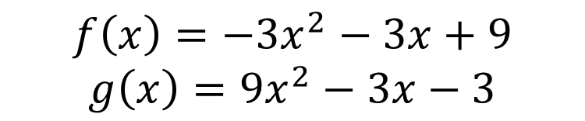
Area between Parabolas
What’s the area bounded by these parabolas?
$$f\left(x\right)=−3x^{2}−3x+9$$
$$g\left(x\right)=9x^{2}−3x−3$$
Not accurately drawn
J
SIC_24

Slide 25
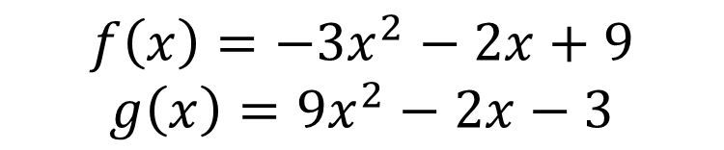
Area between Parabolas
What’s the area bounded by these parabolas?
$$f\left(x\right)=−3x^{2}−2x+9$$
$$g\left(x\right)=9x^{2}−2x−3$$
Not accurately drawn
K
SIC_24

Slide 26
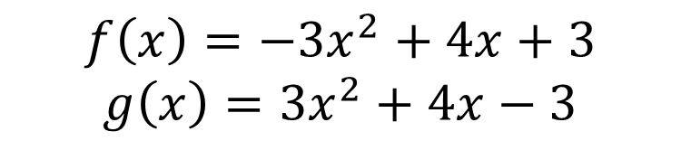
Area between Parabolas
What’s the area bounded by these parabolas?
$$f\left(x\right)=−3x^{2}+4x+3$$
$$g\left(x\right)=3x^{2}+4x−3$$
Not accurately drawn
L
SIC_24

Slide 27
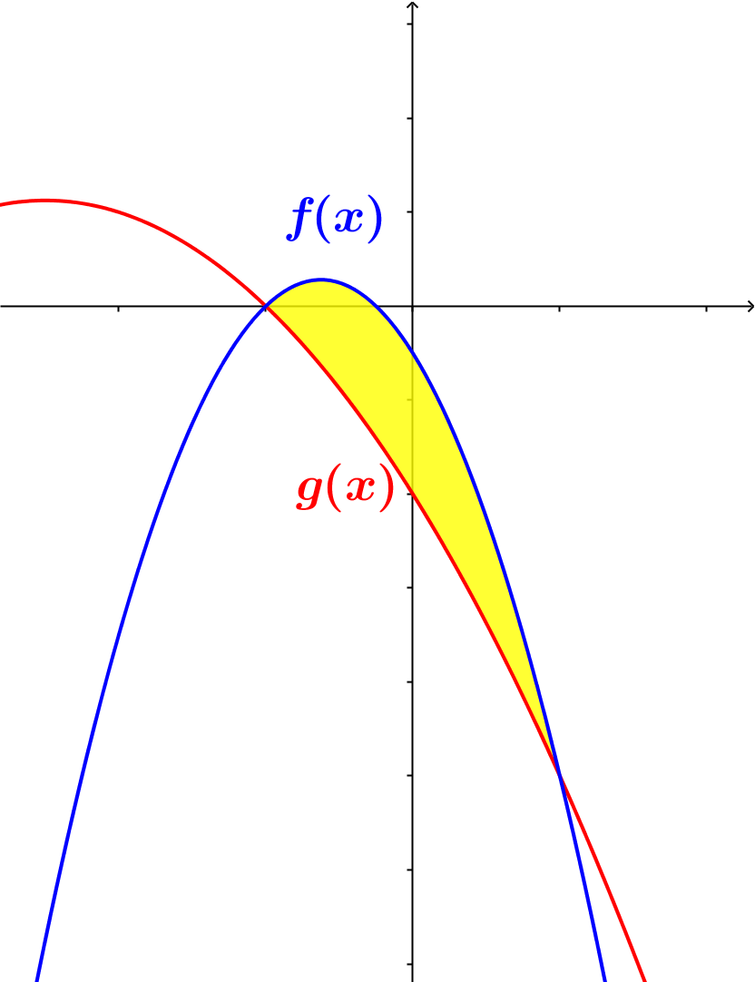
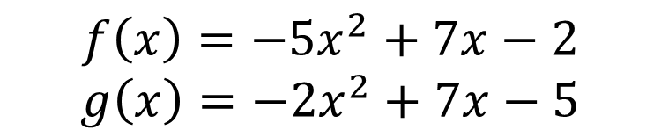
Area between Parabolas
What’s the area bounded by these parabolas?
$$f\left(x\right)=−5x^{2}+7x−2$$
$$g\left(x\right)=−2x^{2}+7x−5$$
Not accurately drawn
M
SIC_24

Slide 28
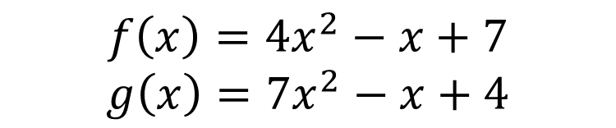
Area between Parabolas
What’s the area bounded by these parabolas?
$$f\left(x\right)={4x}^{2}−x+7$$
$$g\left(x\right)=7x^{2}−x+4$$
Not accurately drawn
N
SIC_24

Slide 29
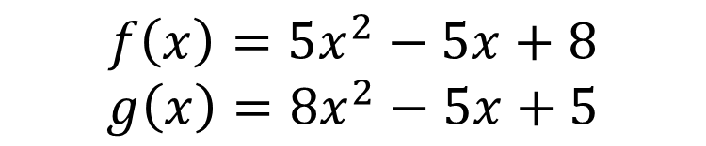
Area between Parabolas
What’s the area bounded by these parabolas?
$$f\left(x\right)=5x^{2}−5x+8$$
$$g\left(x\right)=8x^{2}−5x+5$$
Not accurately drawn
O
SIC_24

Slide 30
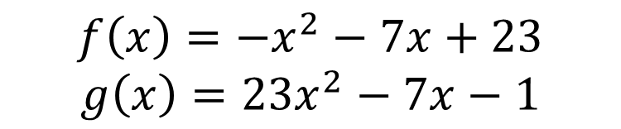
Area between Parabolas
What’s the area bounded by these parabolas?
$$f\left(x\right)=−x^{2}−7x+23$$
$$g\left(x\right)=23x^{2}−7x−1$$
Not accurately drawn
P
SIC_24

Slide 31
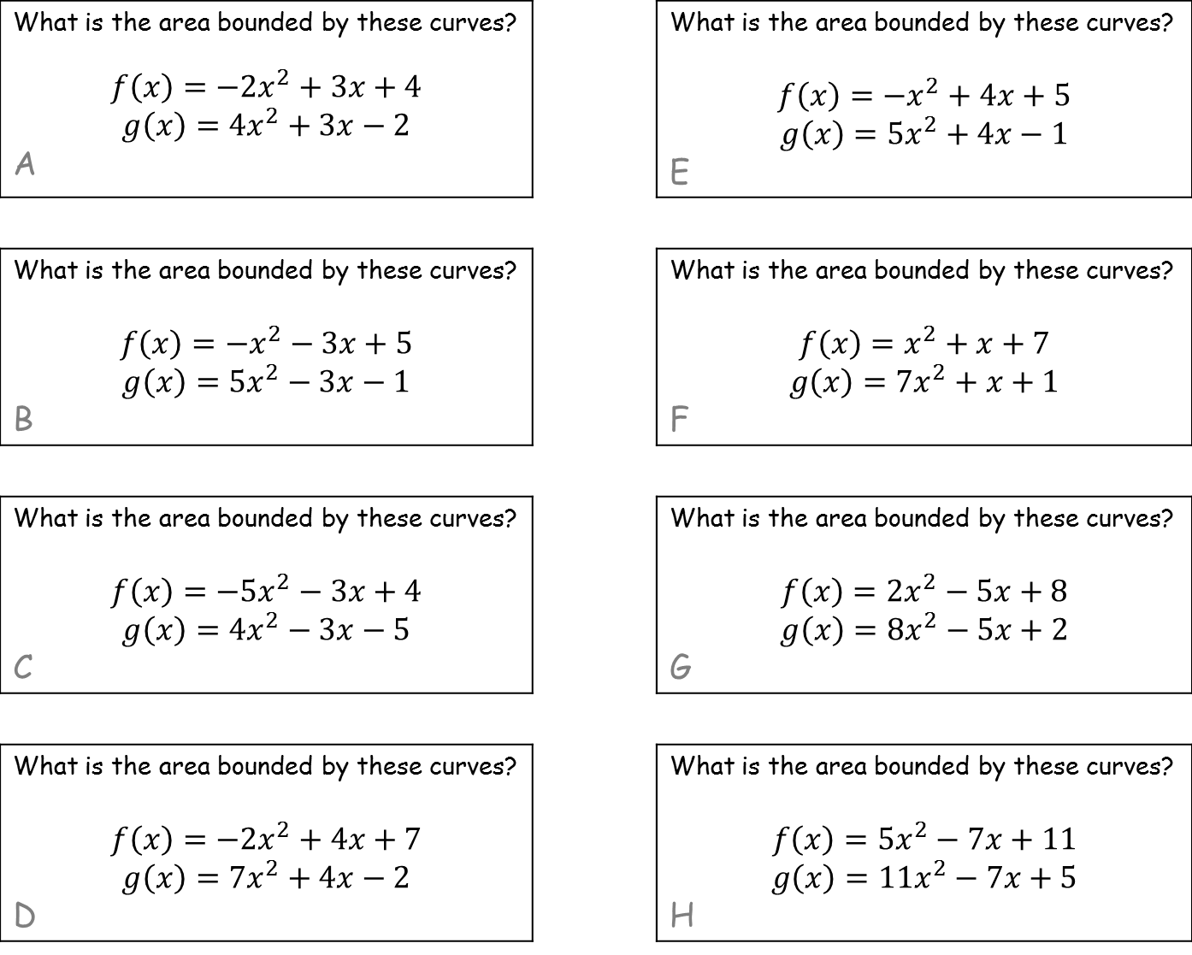
What is the area bounded by these curves? $$f\left(x\right)=−2x^{2}+3x+4$$ $$g\left(x\right)=4x^{2}+3x−2$$ A |  | What is the area bounded by these curves? $$f\left(x\right)=−x^{2}+4x+5$$ $$g\left(x\right)=5x^{2}+4x−1$$ E
What is the area bounded by these curves? $$f\left(x\right)=−x^{2}−3x+5$$ $$g\left(x\right)=5x^{2}−3x−1$$ B |  | What is the area bounded by these curves? $$f\left(x\right)=x^{2}+x+7$$ $$g\left(x\right)=7x^{2}+x+1$$ F
What is the area bounded by these curves? $$f\left(x\right)=−5x^{2}−3x+4$$ $$g\left(x\right)=4x^{2}−3x−5$$ C |  | What is the area bounded by these curves? $$f\left(x\right)=2x^{2}−5x+8$$ $$g\left(x\right)=8x^{2}−5x+2$$ G
What is the area bounded by these curves? $$f\left(x\right)=−2x^{2}+4x+7$$ $$g\left(x\right)=7x^{2}+4x−2$$ D |  | What is the area bounded by these curves? $$f\left(x\right)=5x^{2}−7x+11$$ $$g\left(x\right)=11x^{2}−7x+5$$ H
SIC_24
SIC_24
SIC_24
SIC_24
SIC_24
SIC_24
SIC_24
SIC_24

Slide 32
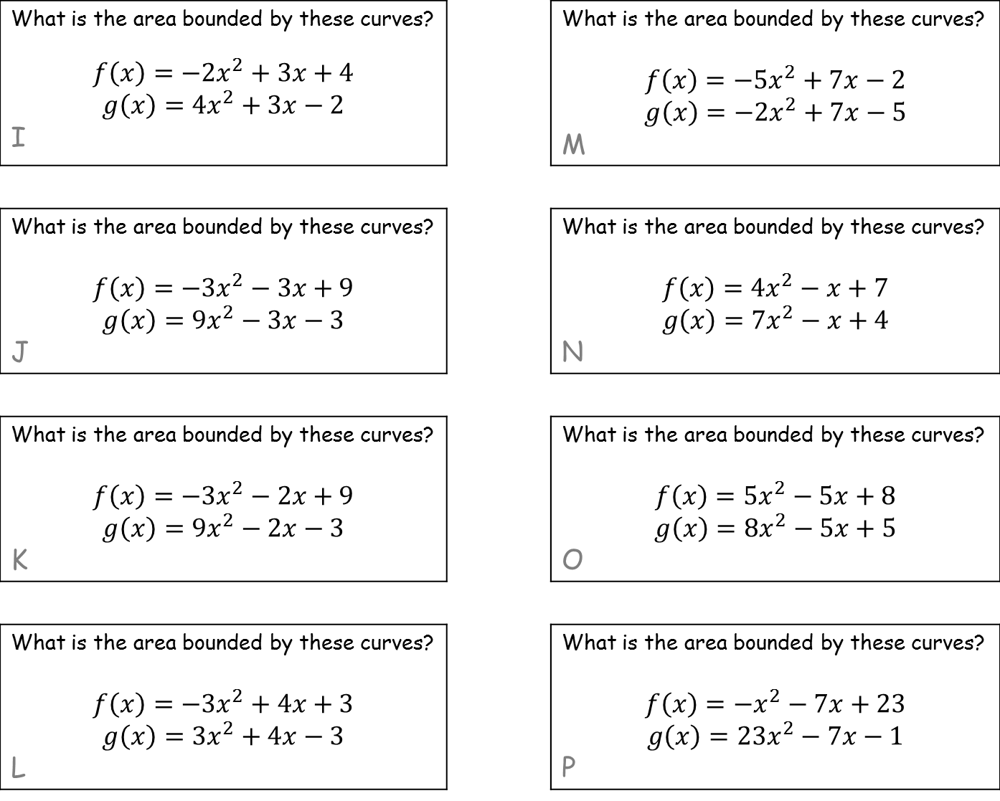
What is the area bounded by these curves? $$f\left(x\right)=−2x^{2}+3x+4$$ $$g\left(x\right)=4x^{2}+3x−2$$ I |  | What is the area bounded by these curves? $$f\left(x\right)=−5x^{2}+7x−2$$ $$g\left(x\right)=−2x^{2}+7x−5$$ M
What is the area bounded by these curves? $$f\left(x\right)=−3x^{2}−3x+9$$ $$g\left(x\right)=9x^{2}−3x−3$$ J |  | What is the area bounded by these curves? $$f\left(x\right)={4x}^{2}−x+7$$ $$g\left(x\right)=7x^{2}−x+4$$ N
What is the area bounded by these curves? $$f\left(x\right)=−3x^{2}−2x+9$$ $$g\left(x\right)=9x^{2}−2x−3$$ K |  | What is the area bounded by these curves? $$f\left(x\right)=5x^{2}−5x+8$$ $$g\left(x\right)=8x^{2}−5x+5$$ O
What is the area bounded by these curves? $$f\left(x\right)=−3x^{2}+4x+3$$ $$g\left(x\right)=3x^{2}+4x−3$$ L |  | What is the area bounded by these curves? $$f\left(x\right)=−x^{2}−7x+23$$ $$g\left(x\right)=23x^{2}−7x−1$$ P
SIC_24
SIC_24
SIC_24
SIC_24
SIC_24
SIC_24
SIC_24
SIC_24

